Slide 1
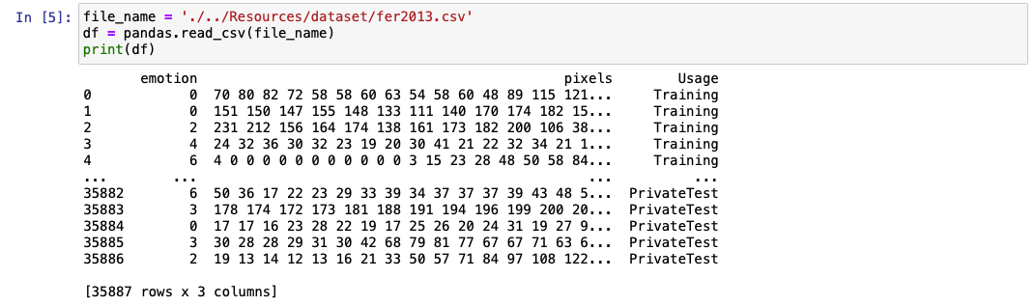
SVM
Started by preparing the dataset (training / test-set)
2.304 dimensional input-data
Output: 1 … 6 for different emotions

Slide 2
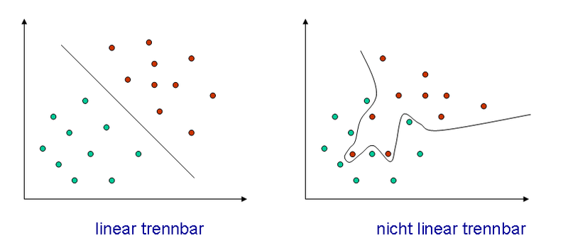
SVM
2.304 dimensional input data
Find hyperplane to seperate data
Apply kernel trick for non-linear data

Slide 3
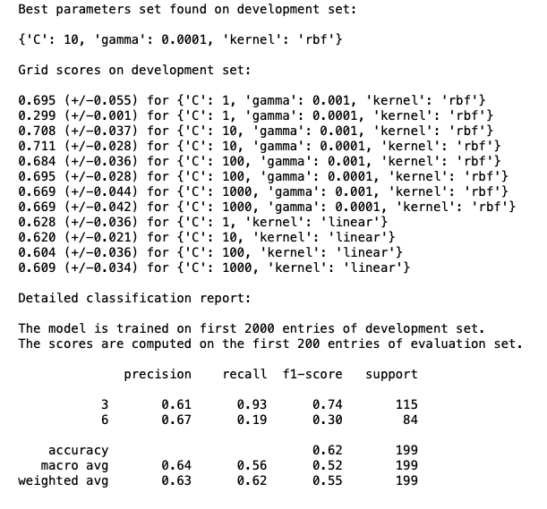
SVM
Grid search for optimal paramters
Best parameter choice is: Kernel: rbf-Kernel C = 10, Gamma = 0.001

Slide 4
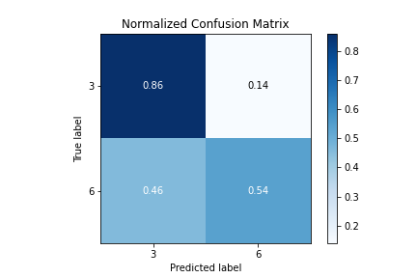
SVM
Accuracy of 45% for all 7 classes
Accuracy of 73% for Happy / Neutral

Slide 5
Quellen Bilder:
All pictures are free for non-commercial use.
Deckblatt: https://commons.wikimedia.org/wiki/File:Emotion_Recognition_Deficit.jpg
Agenda:
https://commons.wikimedia.org/wiki/File:Hey_Machine_Learning_Logo.png
Intro:
https://commons.wikimedia.org/wiki/File:5th_Floor_Lecture_Hall.jpg
https://www.pikist.com/free-photo-sobwr
SVM:
https://de.wikipedia.org/wiki/Datei:Diskriminanzfunktion.png
Project:
Product:

